Slide 1
Scalable Multi-Period Optimal Power Flow for Active Power Distribution Systems or simply, Scalable MP-OPF in ADS
Aryan Ritwajeet Jha
Graduate Research Assistant
Washington State University
Notes:
Remember to hit the reset button to make sure all the page elements react properly.
There are 20 different layouts that you can choose from.

Slide 2
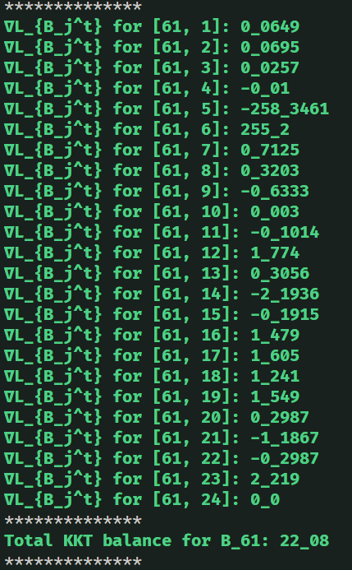
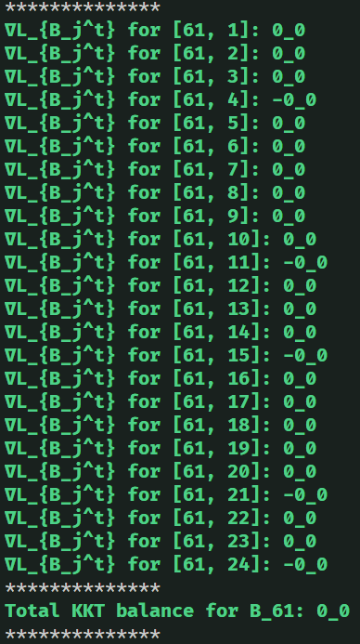
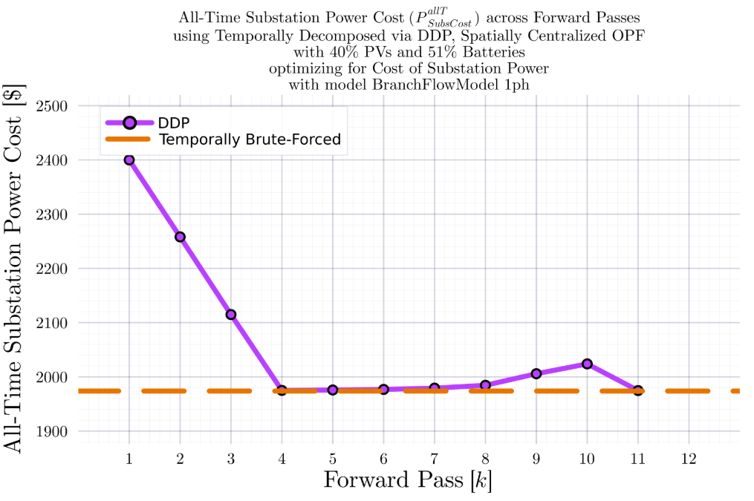
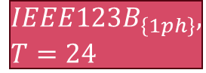


DDP Trajectory vs #Forward Passes $[k]$ Terminal SOC Constraint Relaxed
$$IEEE123B_{\left\{1ph\right\}}, T=24$$
BruteForced (BF)
$$DDP$$
$$k_{Max}=11$$

Slide 3
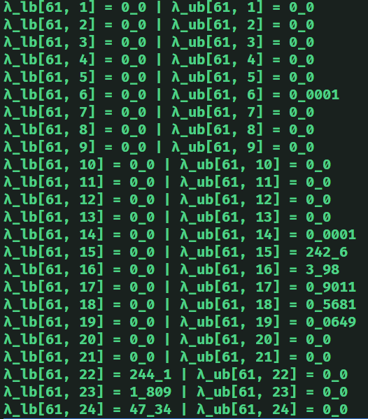
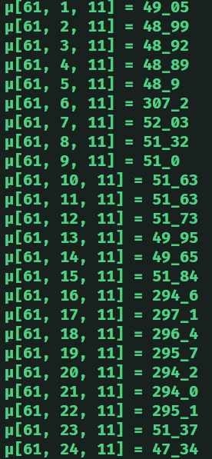

DDP Trajectory vs #Forward Passes $[k]$ Terminal SOC Constraint Relaxed
$$IEEE123B_{\left\{1ph\right\}}, T=24$$
$$DDP$$
$$k_{Max}=11$$

Slide 4

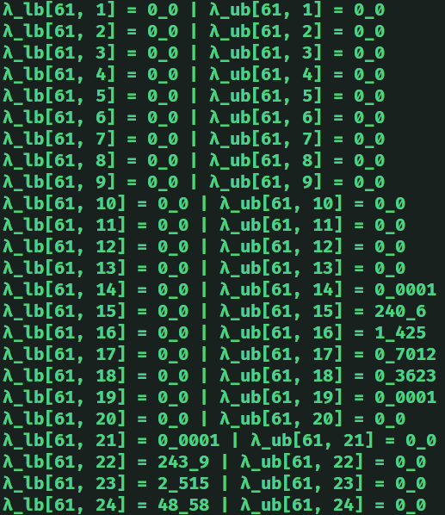
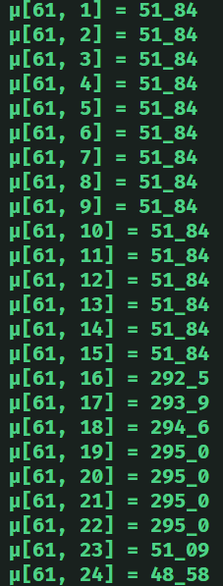
DDP Trajectory vs #Forward Passes $[k]$ Terminal SOC Constraint Relaxed
$$IEEE123B_{\left\{1ph\right\}}, T=24$$
BruteForced (BF)

Slide 5
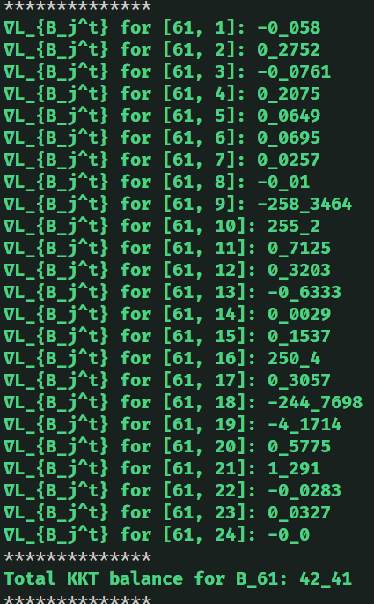
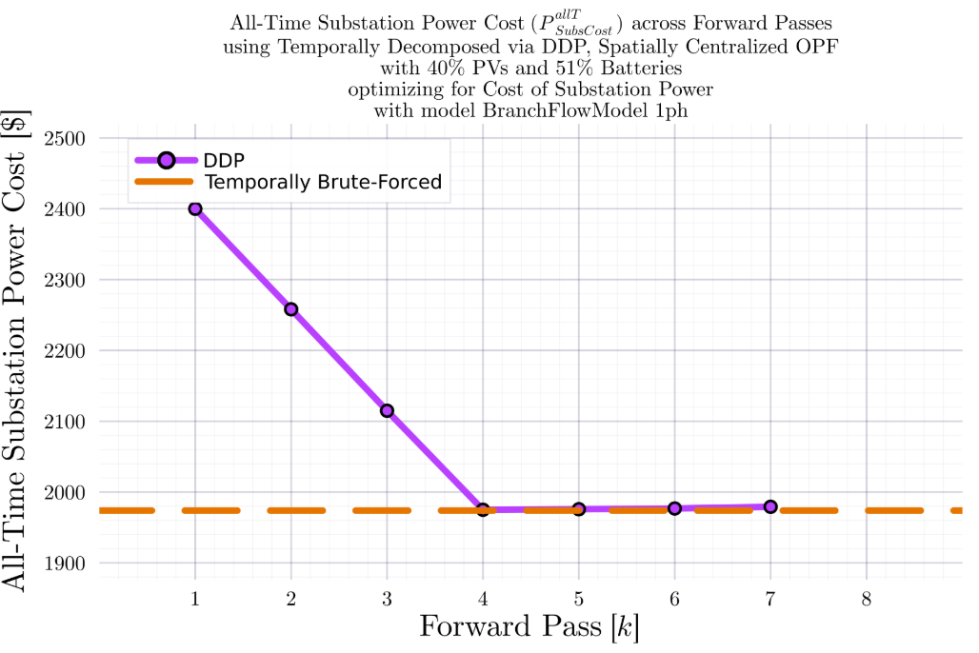

DDP Trajectory vs #Forward Passes $[k]$ Terminal SOC Constraint Relaxed
$$IEEE123B_{\left\{1ph\right\}}, T=24$$
BruteForced (BF)
$$DDP$$
$$k_{Max}=7$$

Slide 6
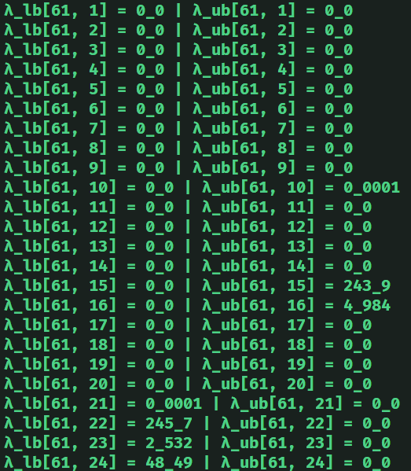
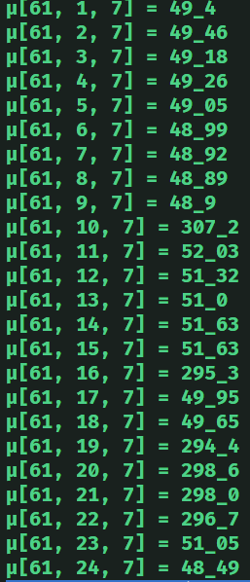
DDP Trajectory vs #Forward Passes $[k]$ Terminal SOC Constraint Relaxed
$$IEEE123B_{\left\{1ph\right\}}, T=24$$
$$DDP$$
$$k_{Max}=11$$

Slide 7
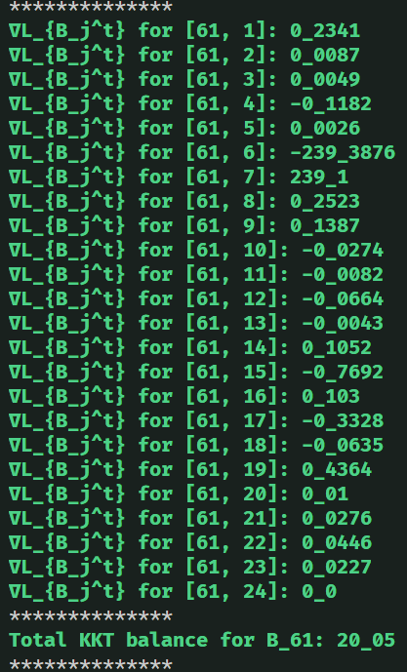
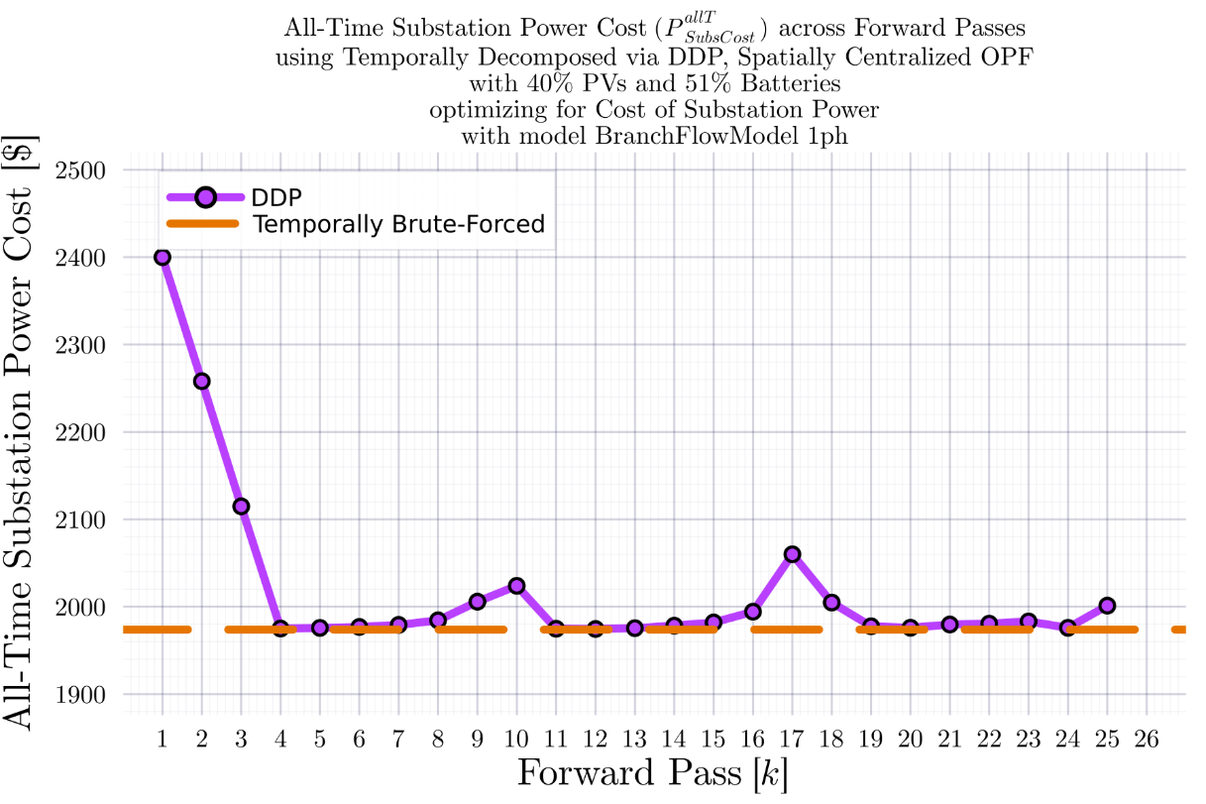

DDP Trajectory vs #Forward Passes $[k]$ Terminal SOC Constraint Relaxed
$$IEEE123B_{\left\{1ph\right\}}, T=24$$
BruteForced (BF)
$$DDP$$
$$k_{Max}=25$$

Slide 8
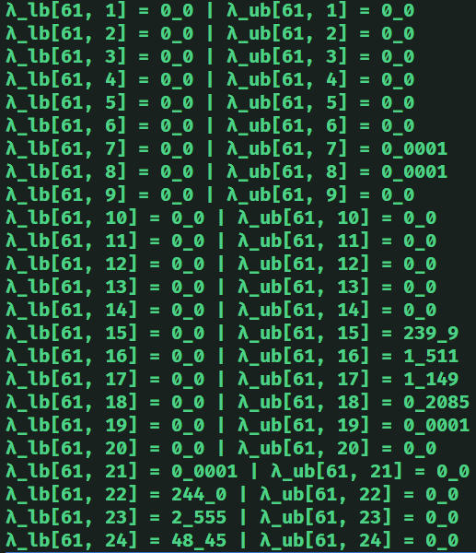
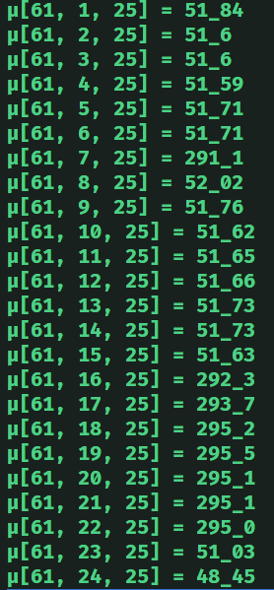

DDP Trajectory vs #Forward Passes $[k]$ Terminal SOC Constraint Relaxed
$$IEEE123B_{\left\{1ph\right\}}, T=24$$
$$DDP$$
$$k_{Max}=25$$

Slide 9

Latest Slides End Here. Previous Slides Follow.

Slide 10
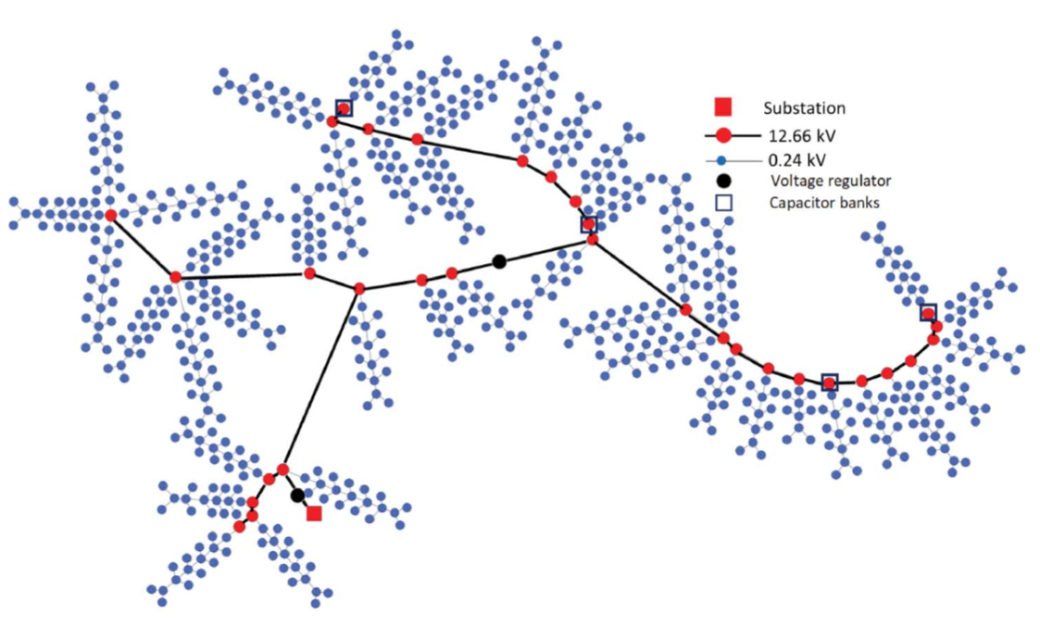
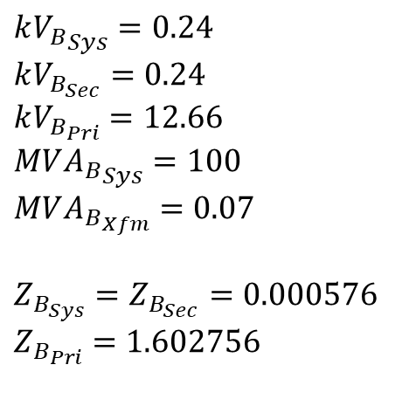
IEEE 730 1ph Node System
34 12.66kV to 12.66kV branches (high impedance)
43 12.66kV to 0.24kV branches (low impedance)
$$k{V_{B}}_{Sys}=0.24$$
$$kV_{B_{Sec}}=0.24$$
$$kV_{B_{Pri}}=12.66$$
$$MV{A_{B}}_{Sys}=100$$
$$MVA_{B_{Xfm}}=0.07$$
$$Z_{B_{Sys}}=Z_{B_{Sec}}=0.000576$$
$$Z_{B_{Pri}}=1.602756$$
1
2
2
2
1
4
1
1
1
0
1
4
1
1
1
1
2
1
2
1
1
1
1
1
1
1
1
1
1
1
1
1
0
1
0
1

Slide 11
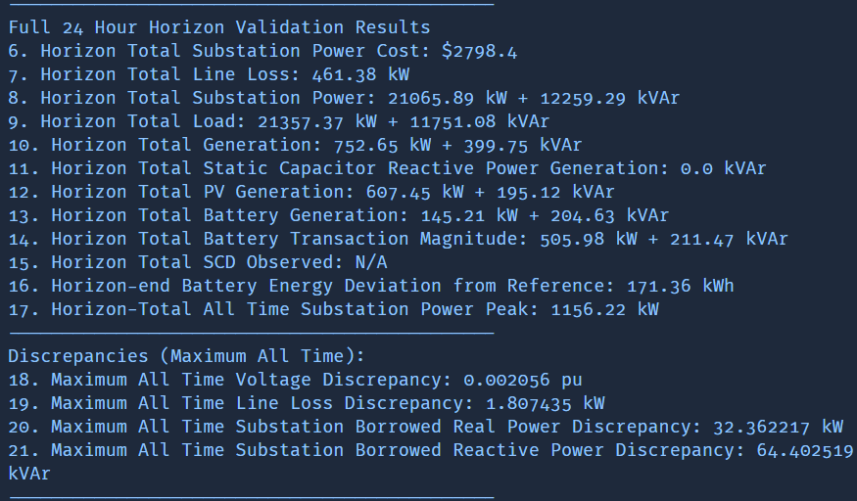
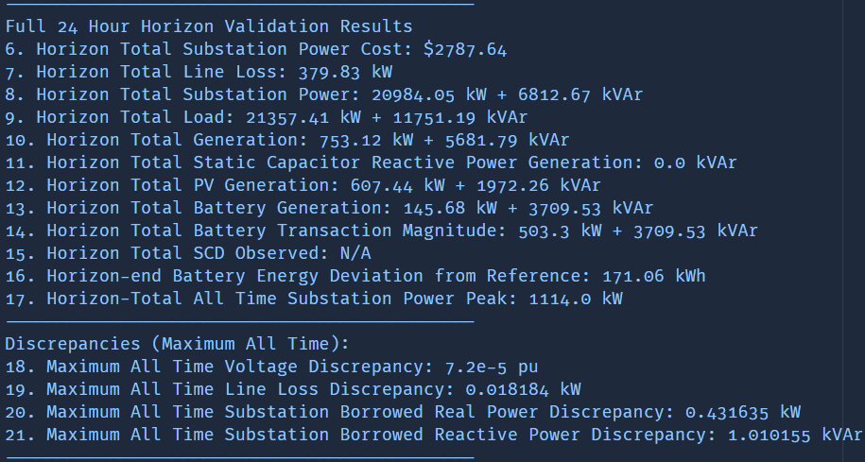
Comparison of BFM-NL-1ph and LinDistFlow-1ph Optimization Results
LinDistFlow Optimal Actions used in OpenDSS
BFM-NL
Optimal Actions used in OpenDSS

Slide 12
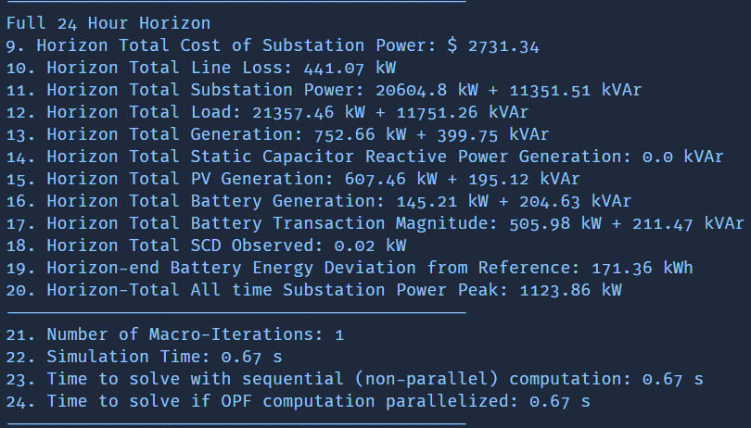
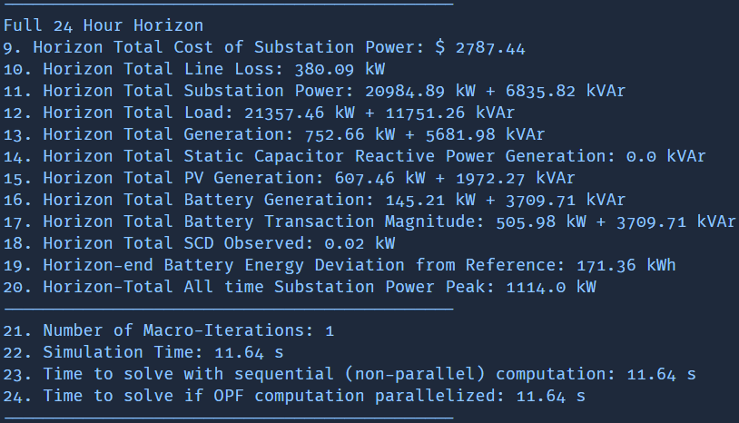
Comparison of BFM-NL-1ph and LinDistFlow-1ph Optimization Results
LinDistFlow Own Solutions
BFM-NL Own Solutions

Slide 13
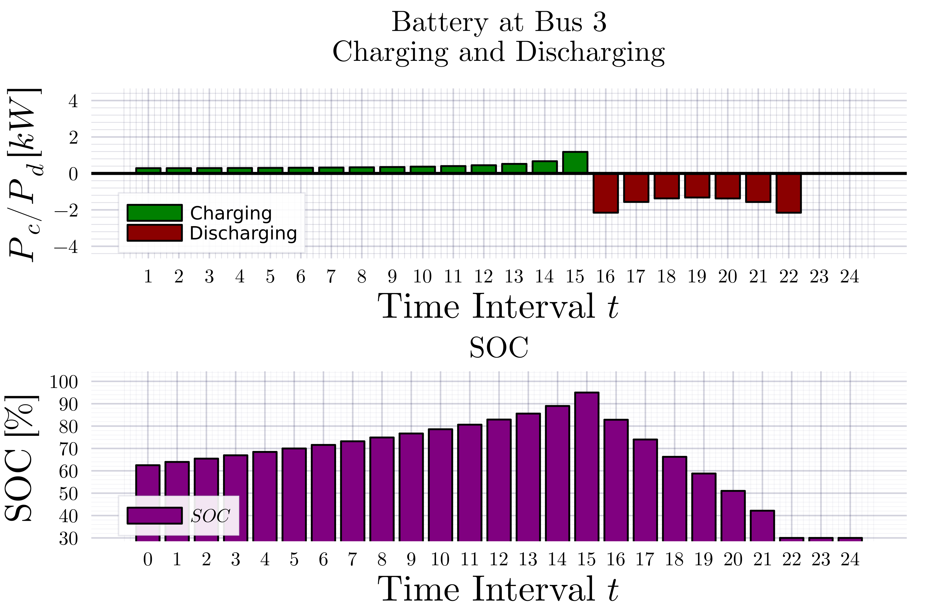
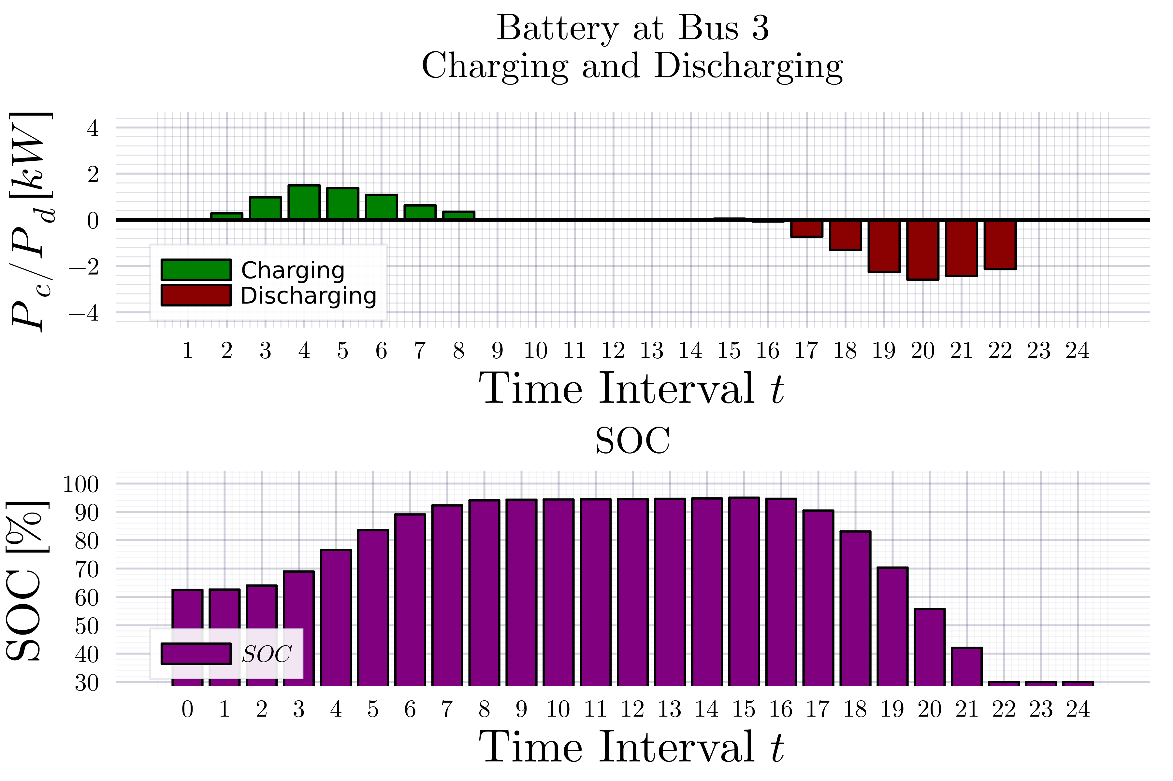
Comparison of BFM-NL-1ph and LinDistFlow-1ph Optimization Results
LinDistFlow
BFM-NL

Slide 14
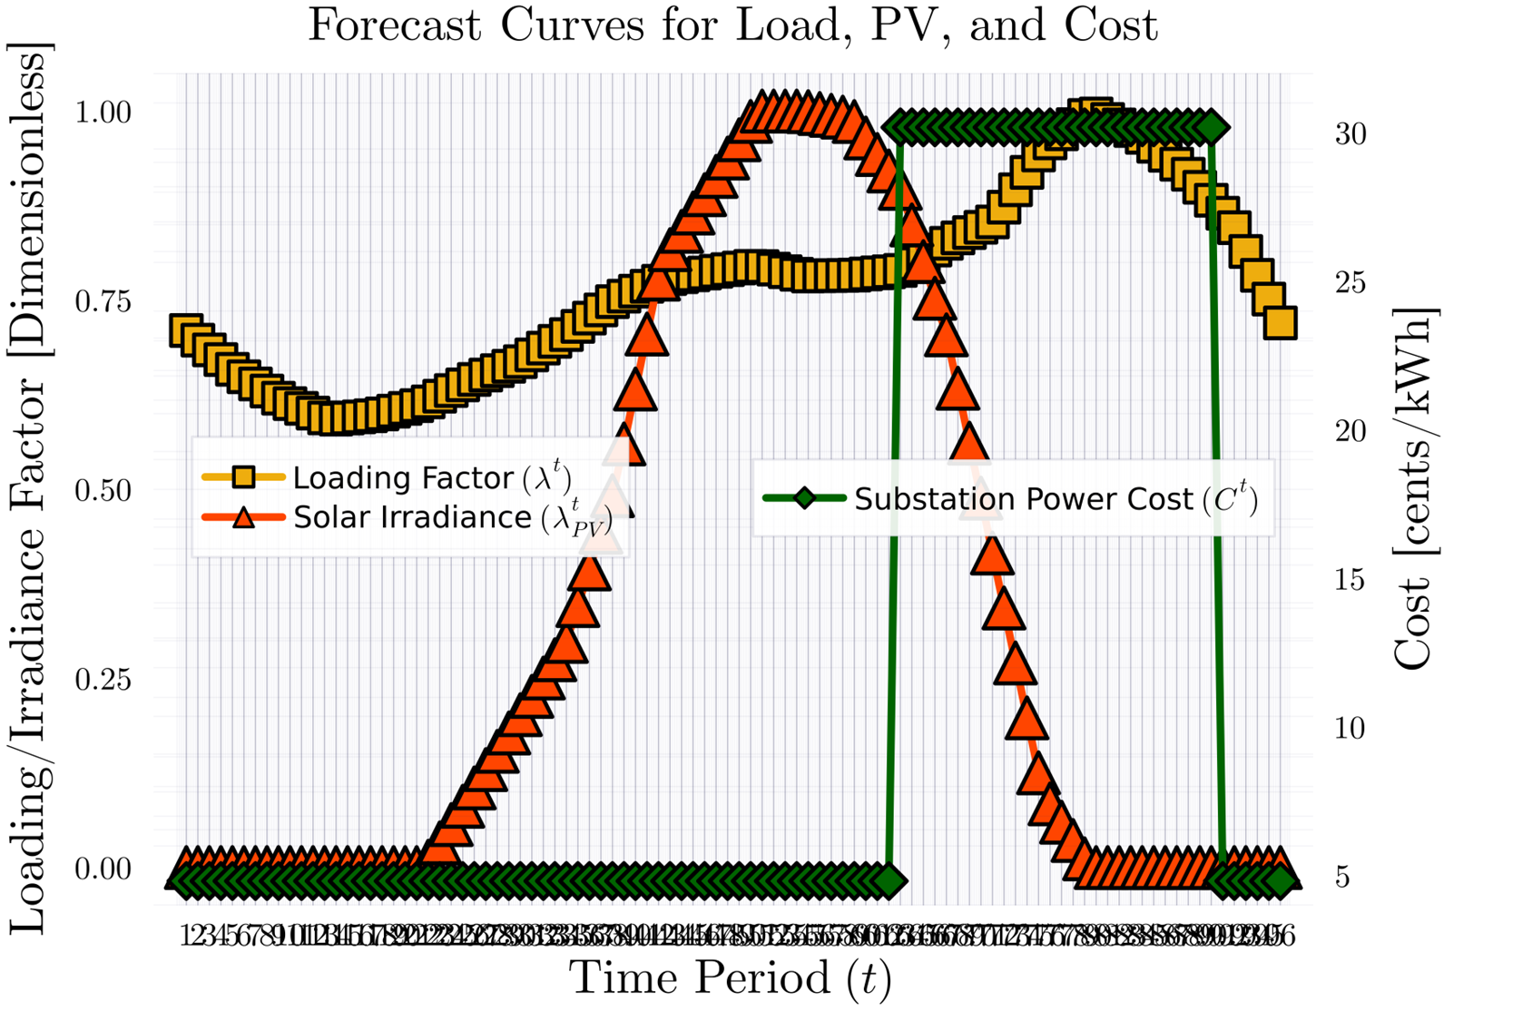
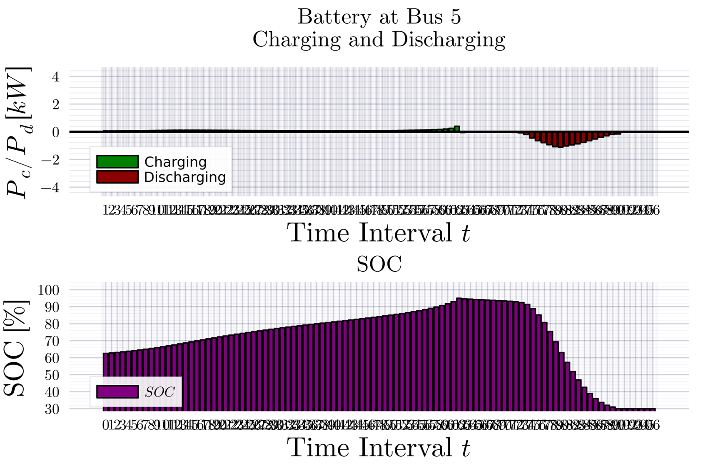
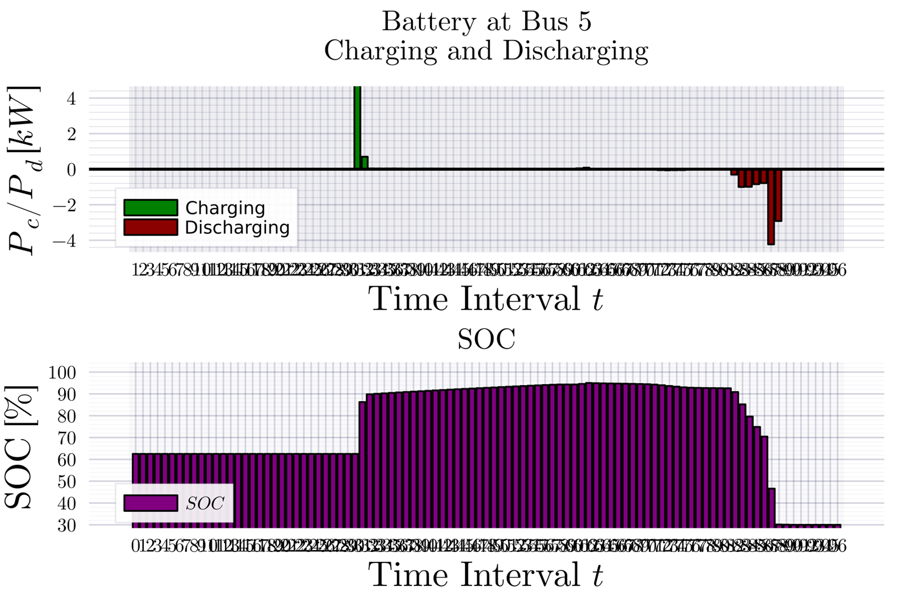
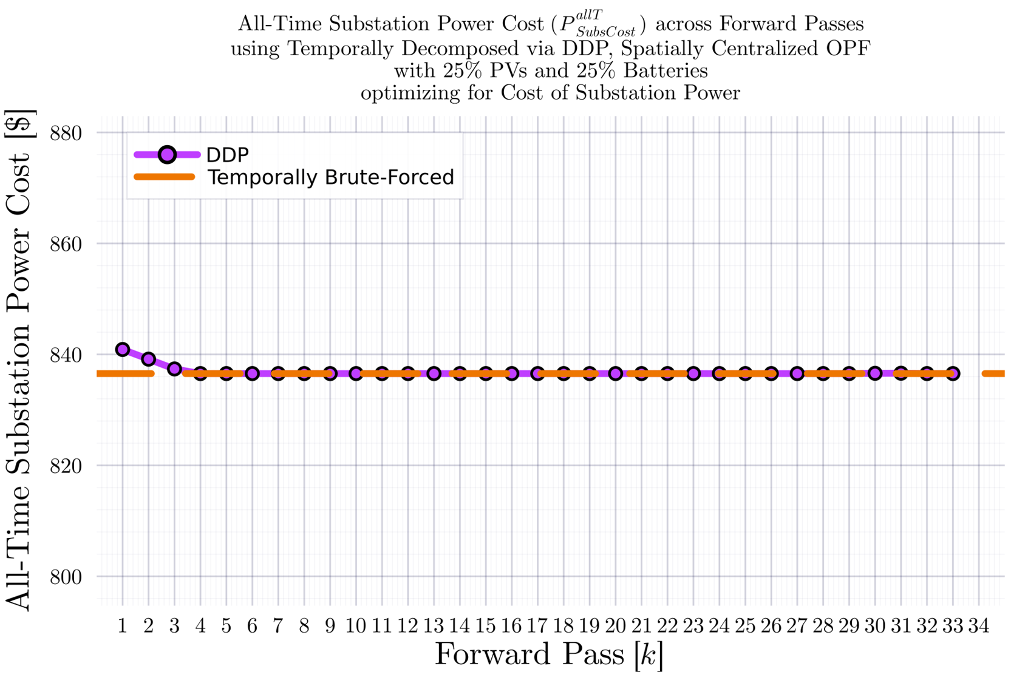
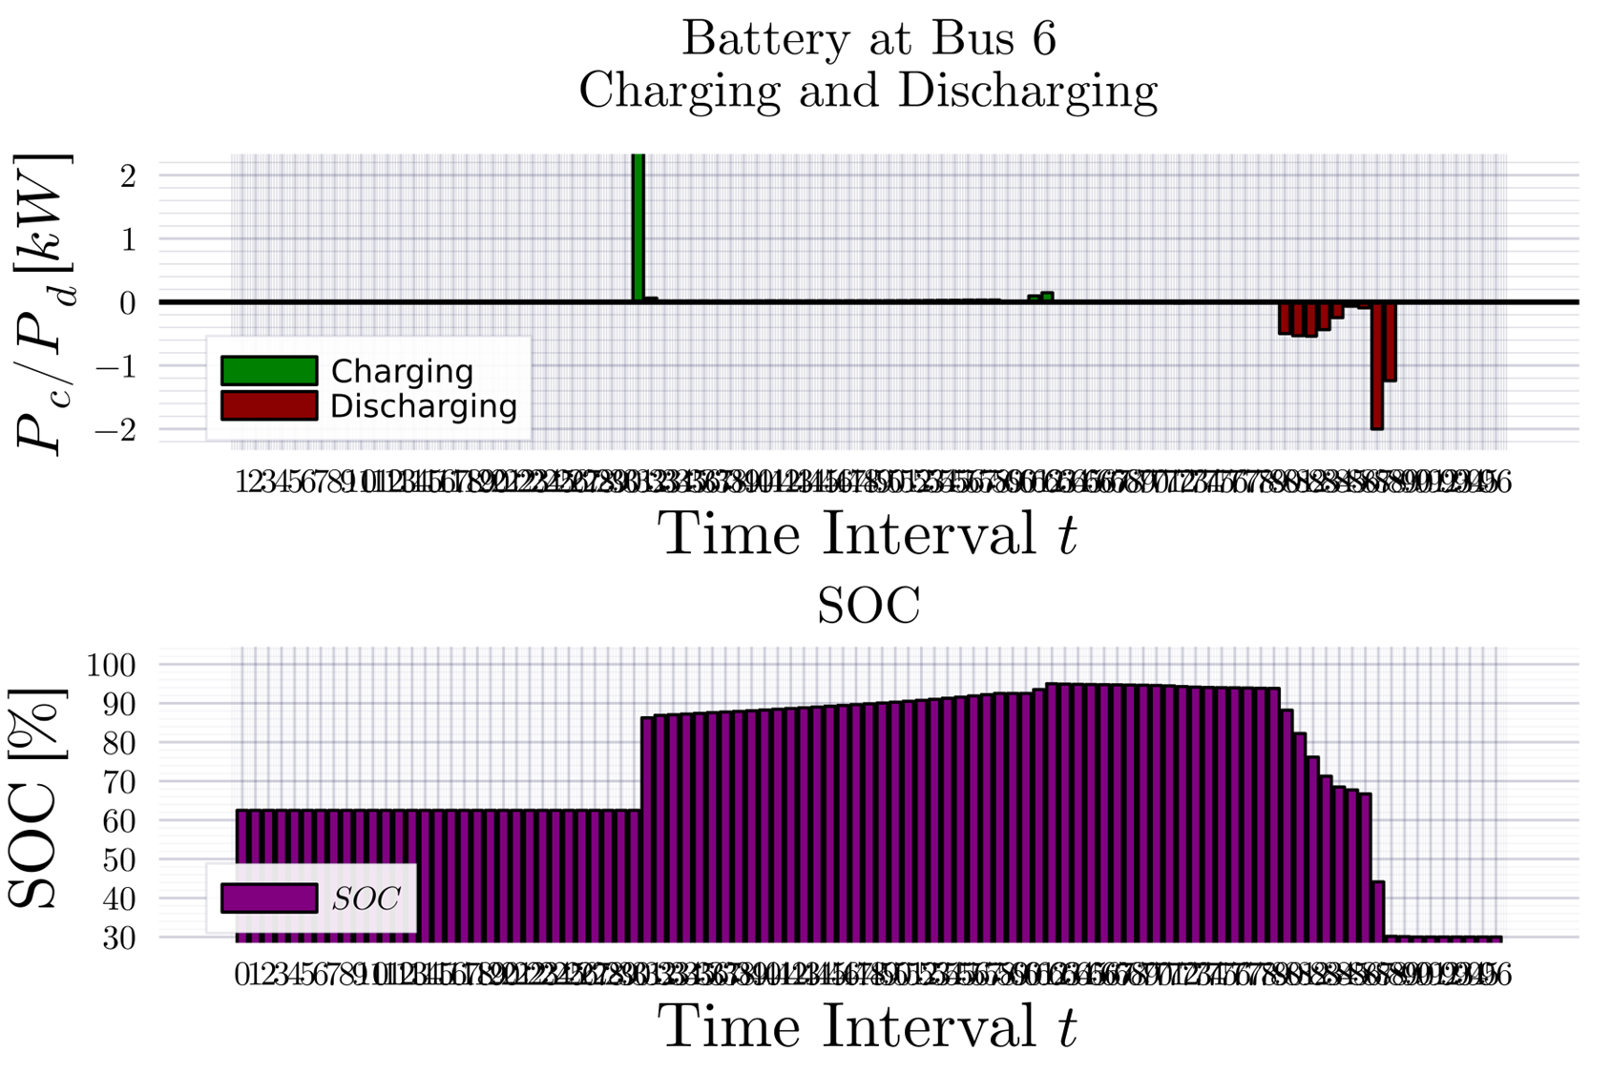

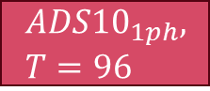

DDP Trajectory vs #Forward Passes $[k]$ Terminal SOC Constraint Relaxed
$$ADS{10}_{1ph}, T=96$$
BruteForced (BF)
$$DDP$$
Looks ‘successful’
$$k_{Max}=33$$

Slide 15
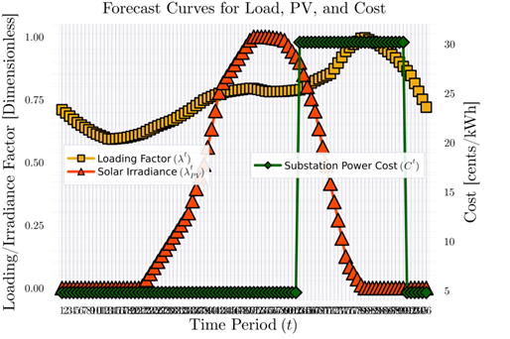
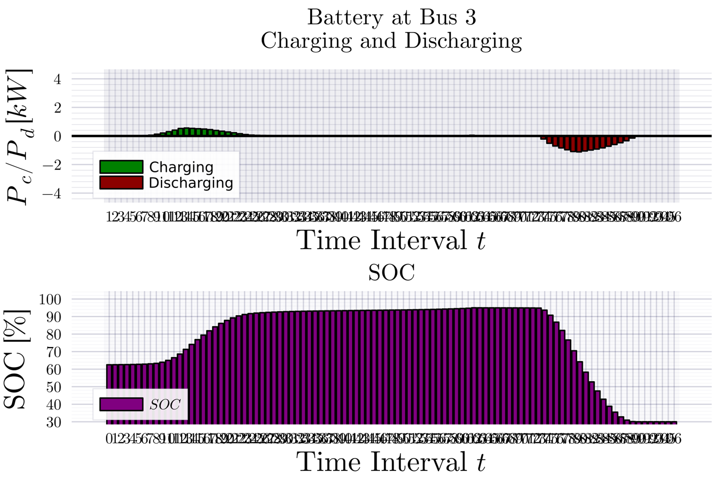
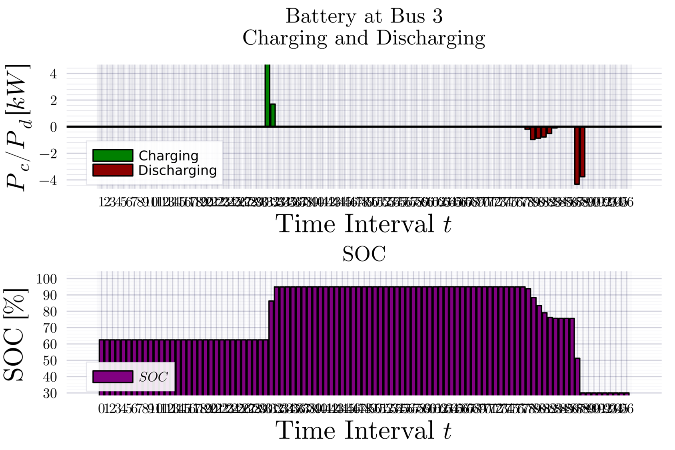
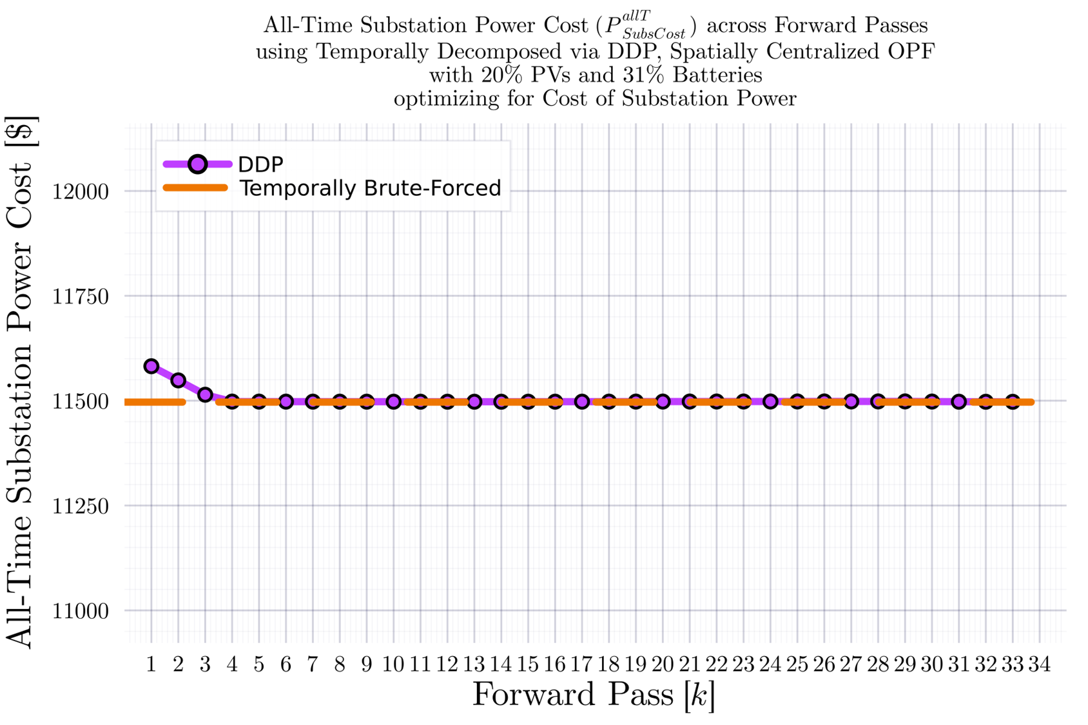

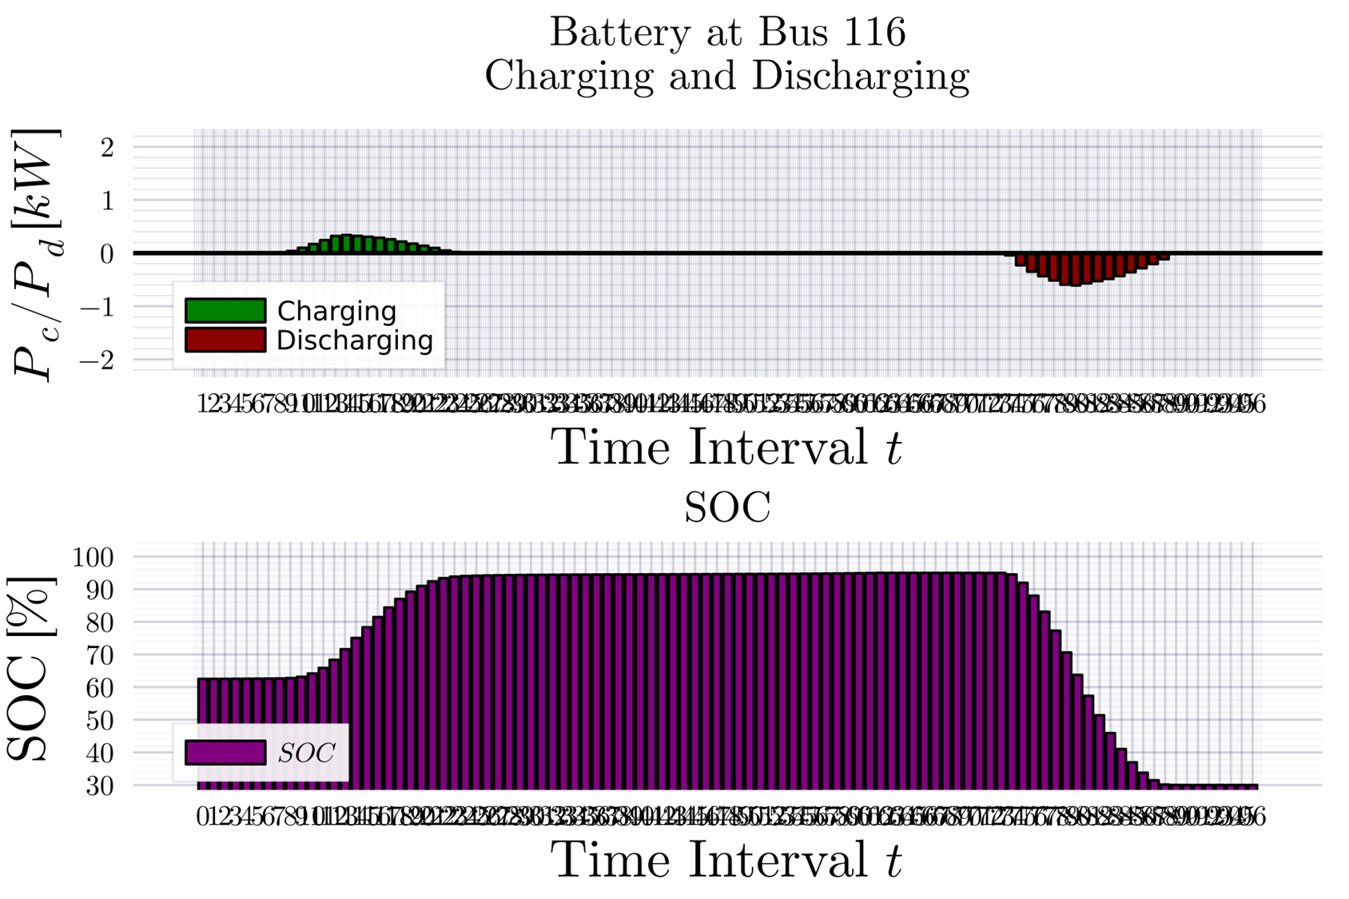
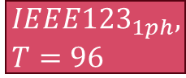
DDP Trajectory vs #Forward Passes $[k]$ Terminal SOC Constraint Relaxed
$$IEEE{123}_{1ph}, T=96$$
BruteForced (BF)
$$DDP$$
Looks ‘successful’
$$k_{Max}=33$$

Slide 16
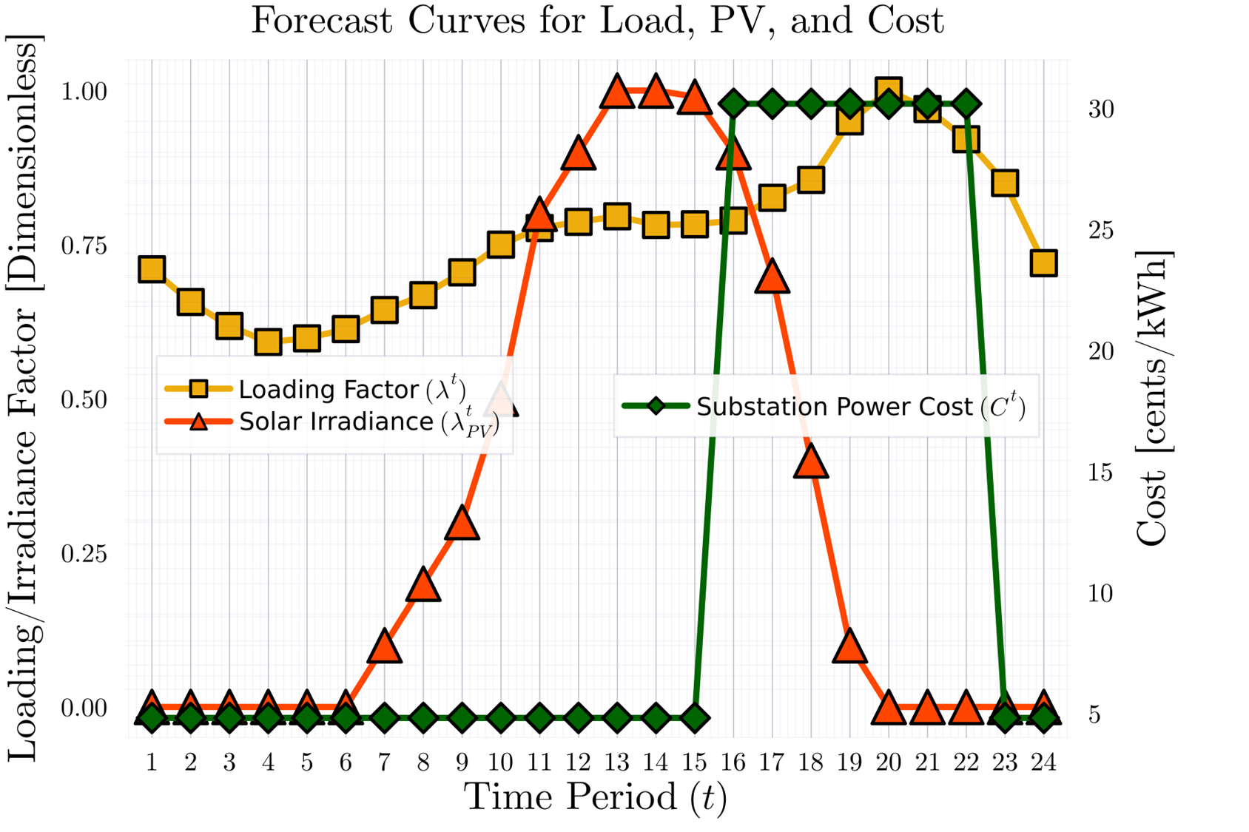
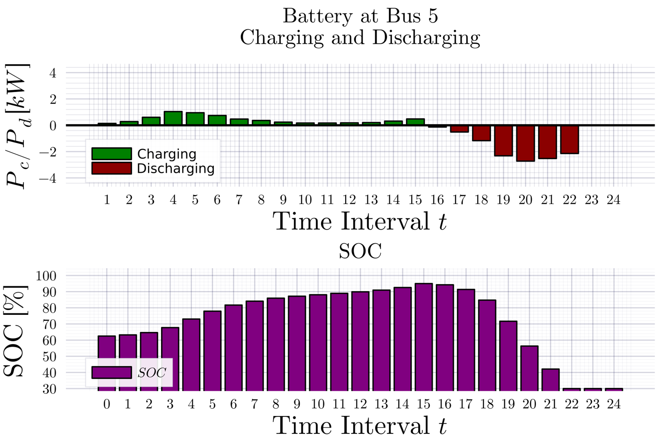
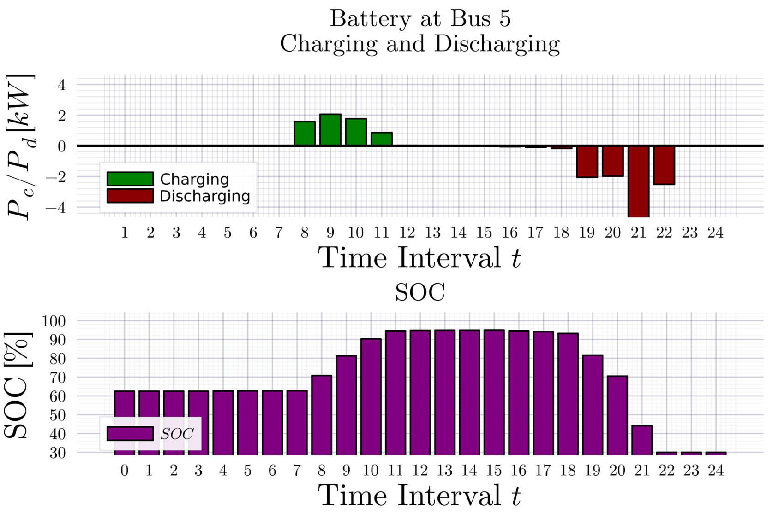
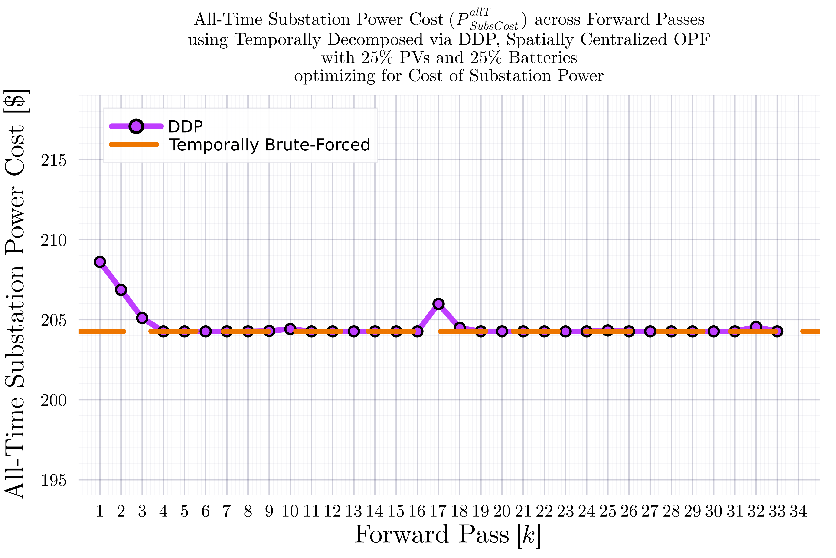
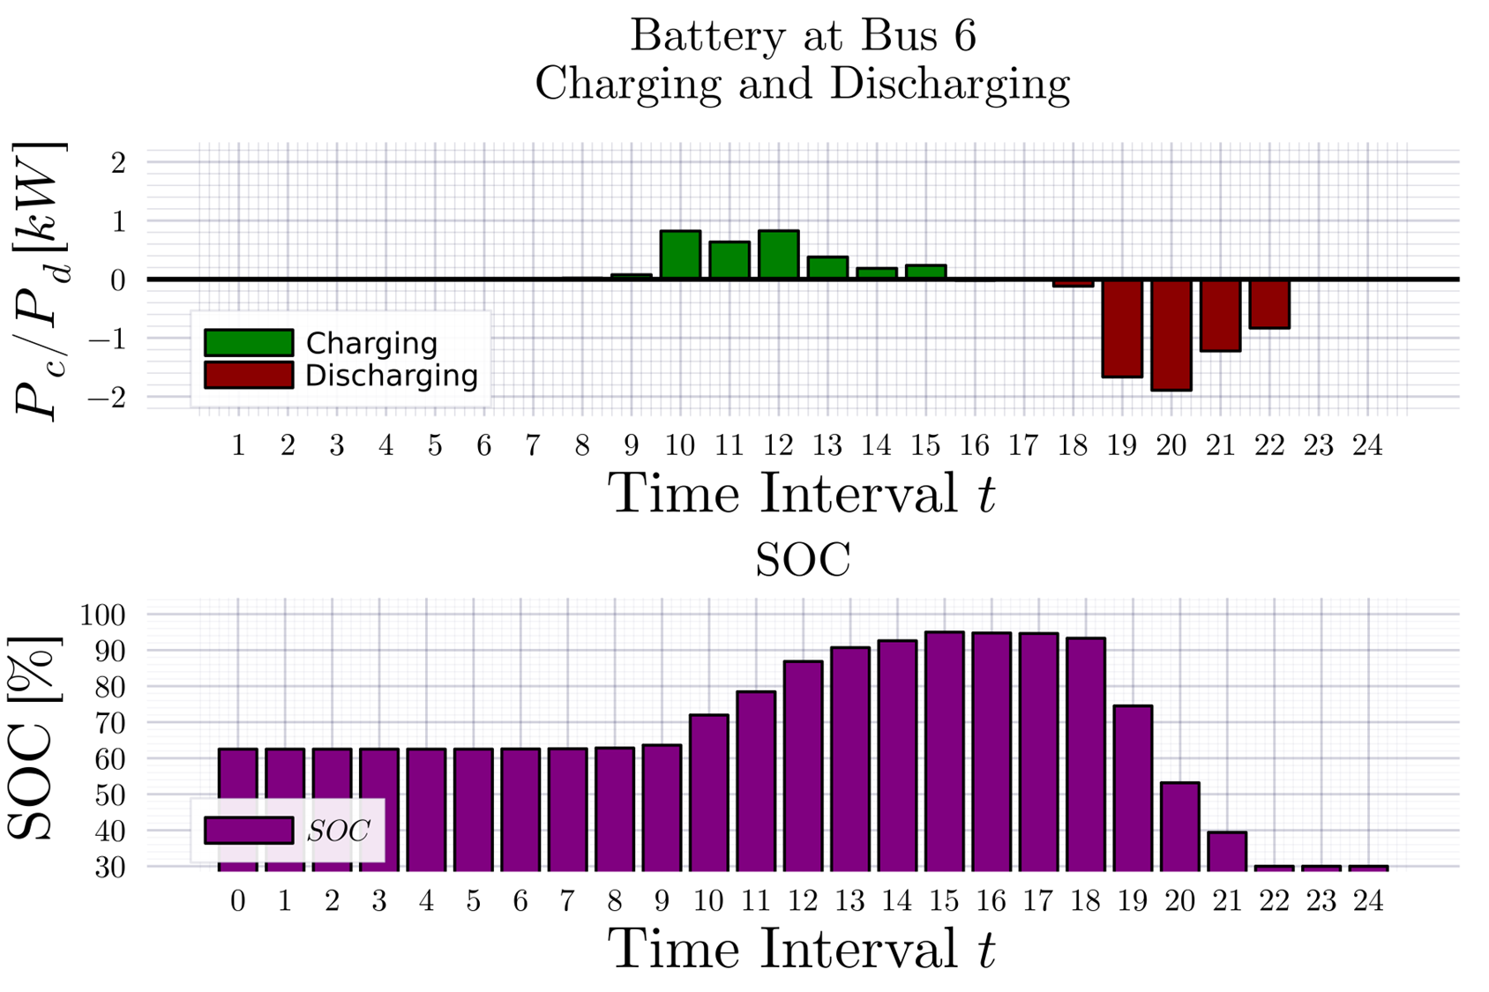
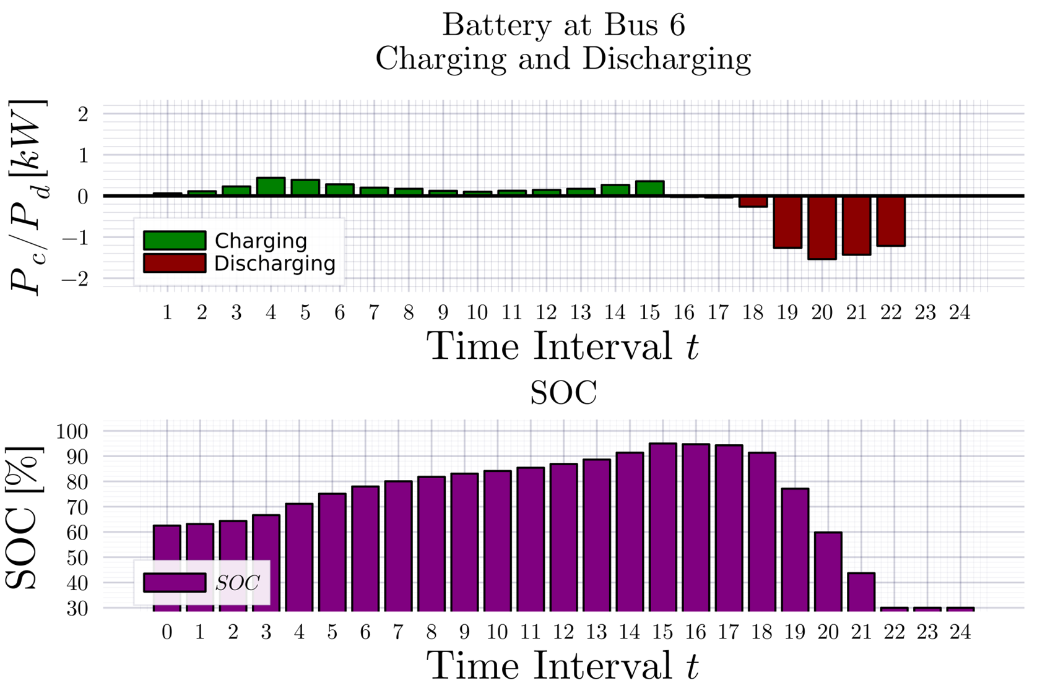
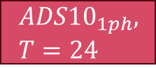
DDP Trajectory vs #Forward Passes $[k]$ Terminal SOC Constraint Relaxed
$$ADS{10}_{1ph}, T=24$$
BruteForced (BF)
$$DDP$$
Looks ‘successful’
$$k_{Max}=33$$

Slide 17
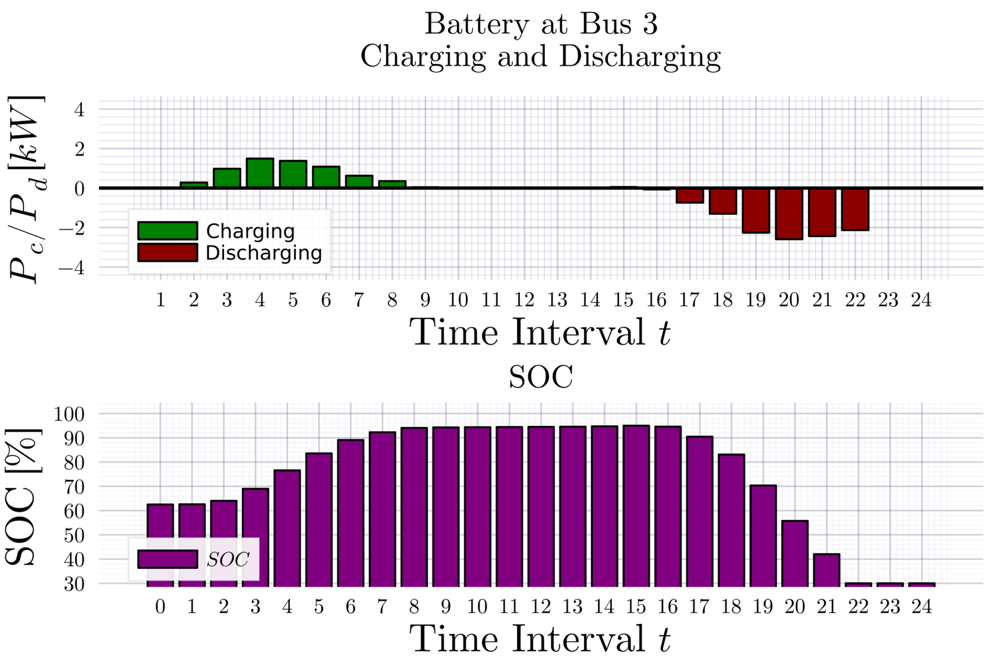
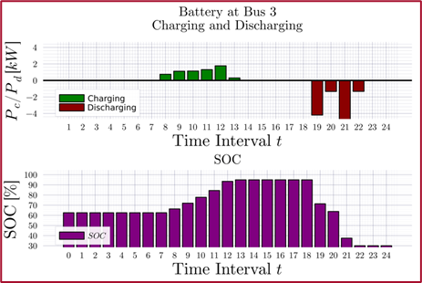
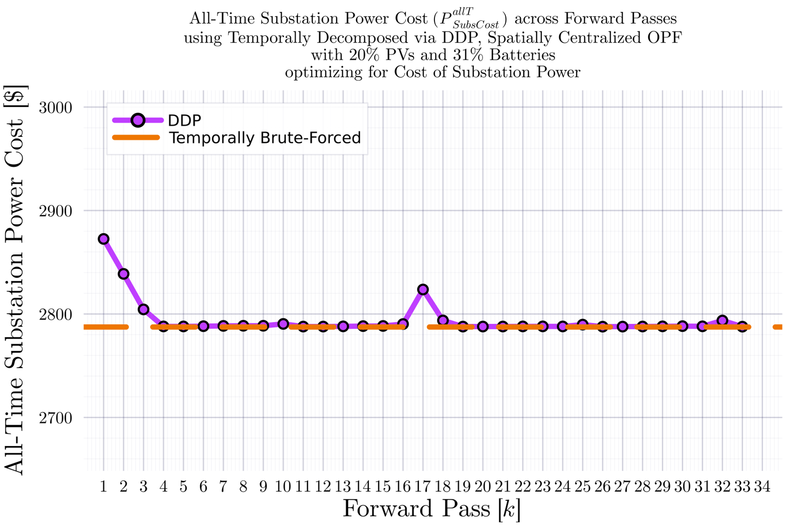
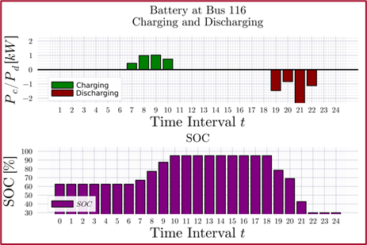
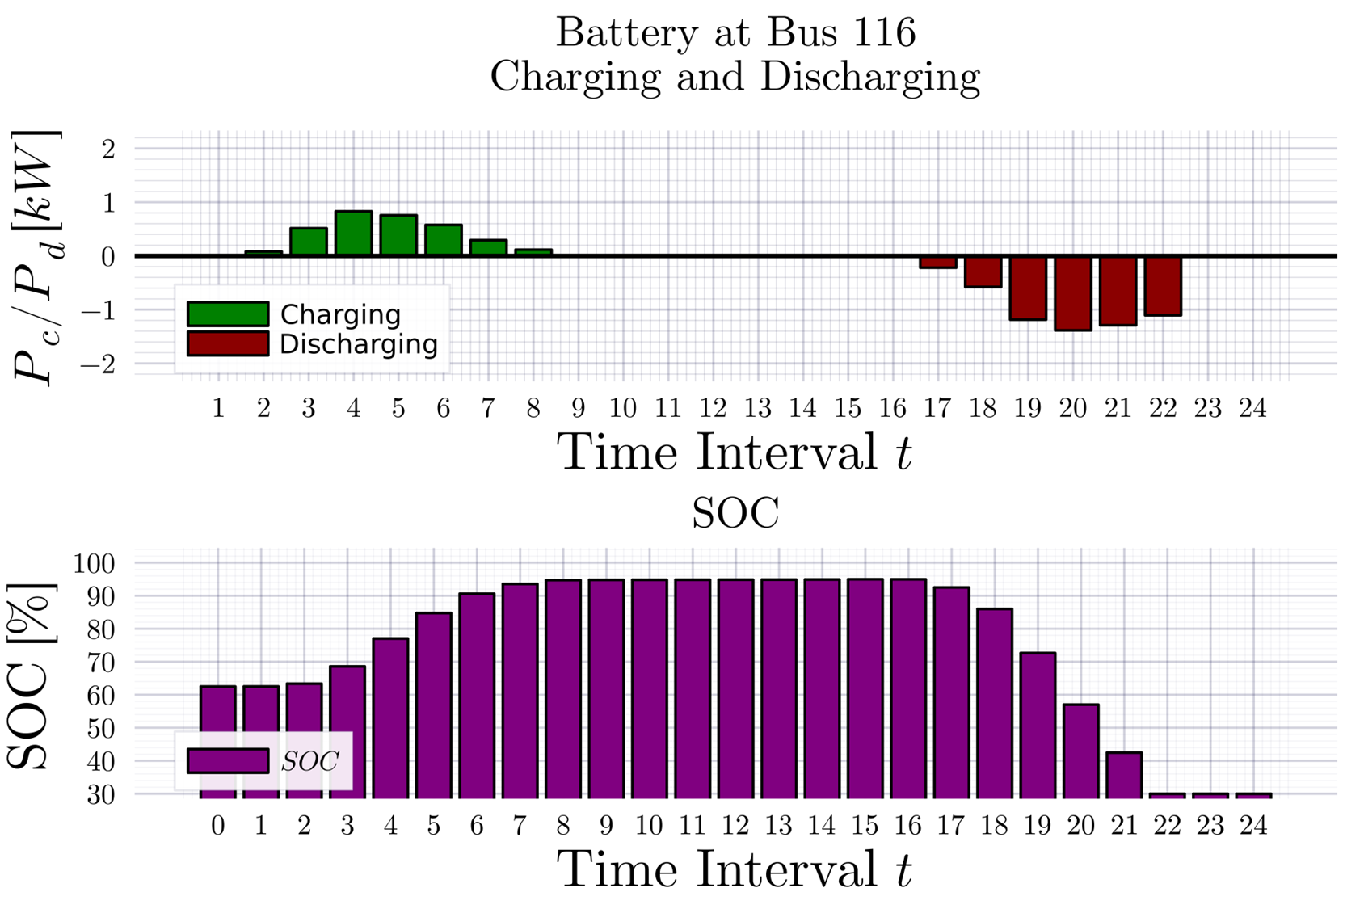
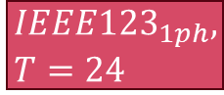
DDP Trajectory vs #Forward Passes $[k]$ Terminal SOC Constraint Relaxed
$$IEEE{123}_{1ph}, T=24$$
BruteForced (BF)
$$DDP$$
Looks ‘successful’
$$k_{Max}=33$$

Slide 18
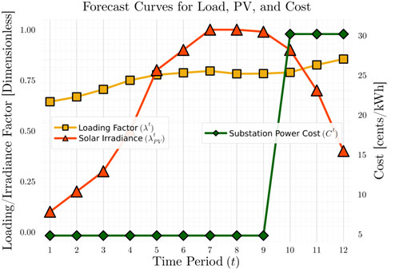






DDP Trajectory vs #Forward Passes $[k]$ Terminal SOC Constraint Relaxed
$$ADS{10}_{1ph}, T=12$$
BruteForced (BF)
$$DDP$$
Will NOT converge
$$k_{Max}=33$$
Even if not converging, it at least does ‘hit’ the optimal value periodically.

Slide 19



DDP Trajectory vs #Forward Passes $[k]$ Terminal SOC Constraint Relaxed
$$ADS{10}_{1ph}, T=12$$
BruteForced (BF)
$$DDP$$
Will NOT converge
$$k_{Max}=55$$
Even if not converging, it at least does ‘hit’ the optimal value periodically.

Slide 20




DDP Trajectory vs #Forward Passes $[k]$ Terminal SOC Constraint Relaxed
$$ADS{10}_{1ph}, T=12$$
BruteForced (BF)
$$DDP$$
Will NOT converge
$$k_{Max}=77$$
Even if not converging, it at least does ‘hit’ the optimal value periodically.

Slide 21




DDP Trajectory vs #Forward Passes $[k]$ Terminal SOC Constraint Relaxed
$$ADS{10}_{1ph}, T=12$$
BruteForced (BF)
$$DDP$$
Will NOT converge
$$k_{Max}=222$$
Even if not converging, it at least does ‘hit’ the optimal value periodically.

Slide 22







DDP Trajectory vs #Forward Passes $[k]$ Terminal SOC Constraint Relaxed
$$IEEE{123}_{1ph}, T=12$$
BruteForced (BF)
$$DDP$$
Will NOT converge
$$k_{Max}=33$$
Even if not converging, it at least does ‘hit’ the optimal value periodically.

